Slide 1
Marija Đokić Petrović¹˒² (Graz, Belgrade)
Mihajlo Stojanović² (Belgrade)
Branko Tošović³ (Graz)
¹Austrian Center for Digital Humanities, Austrian Academy of Sciences
²Union University, Belgrade
³Department of Slavic Studies, University of Graz
mdjokicpetrovic@raf.rs, m_stojanovic@raf.rs, branko.tosovic@uni-graz.at
From Letters to Digital
Research Environment:
Exploring Ivo Andrić’s Letters
through an Interactive Application
18th Symposium „Andrić has spoken“
Paris–Strasbourg–Marseille · 28–31 October 2026

Slide 2
Agenda
Andrić’s Letters in the Scope of Digital Humanities (DH)
From Andrić’s Letters to a Knowledge Graph (KG):
  Workflow: Semi-Automatic Pipeline for KG Creation
From KG to an Interactive Web Application
Previous & Future Work

Slide 3
Letters as a form of communication
Rich and ancient form of communication. It offers deep insights into the thoughts, feelings, and experiences of people from all walks of life in a more immediate way than almost any other medium. As well as the content of letters, the set of circumstances surrounding a letter’s creation, transmission, and reception tells a story in itself [1].

Slide 4
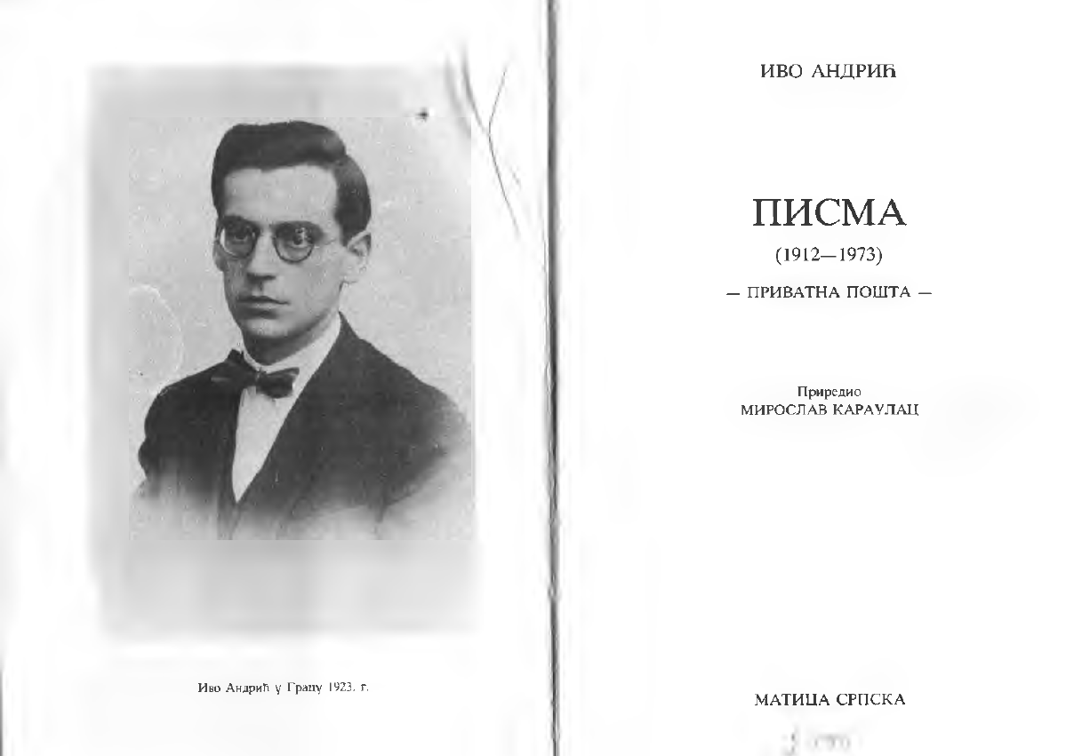
Andrić has spoken ...
[2] I. Andrić, Pisma (1912–1973): privatna pošta / Letters (1912–1973): private post, edited by Miroslav Karaulac, Matica srpska, Novi Sad, 2000. COBISS.BH-ID 11313414.

Slide 5
Andrić’s Letters in the Scope of DH
Andrić’s Letters represent a rich set of cultural-historical data that can be analyzed and connected in ways that go beyond the classical reading of individual letters:
  Reconstruction of Andrić’s personal, professional and intellectual networks.
  Tracing the geography of his correspondence.
  Changes over time can be explored, which is difficult to see only by linear reading.
  Connecting to external sources.
  Creating a layer of structured data for search, visualization and analysis.

Slide 6
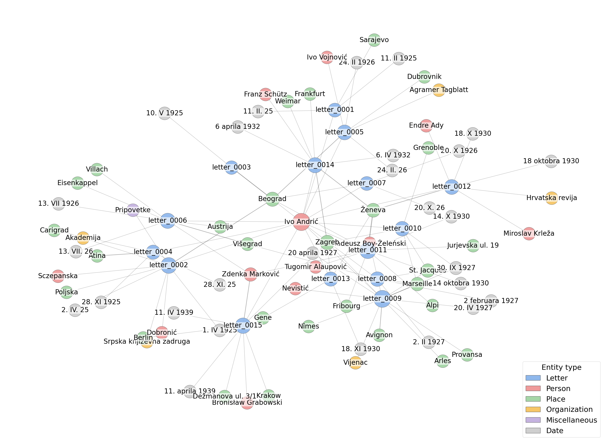
Knowledge graph
Representing information in the form of nodes and edges:
Nodes typically represent people, locations, institutions, publications, ....
Edges represent the connections between them (such as "was born in" or "works at").
[4] Đokić Petrović, M., Stojanović, M., & Tošović, B. (2026). Modeling the Letters of Nobel Laureate Ivo Andrić as a Knowledge Graph. SEMANTiCS 2026 – 22nd International Conference on Semantic Systems. Posters, Demos, Blue Sky, and Tutorials, September 2026, Ghent, Belgium.

Slide 7
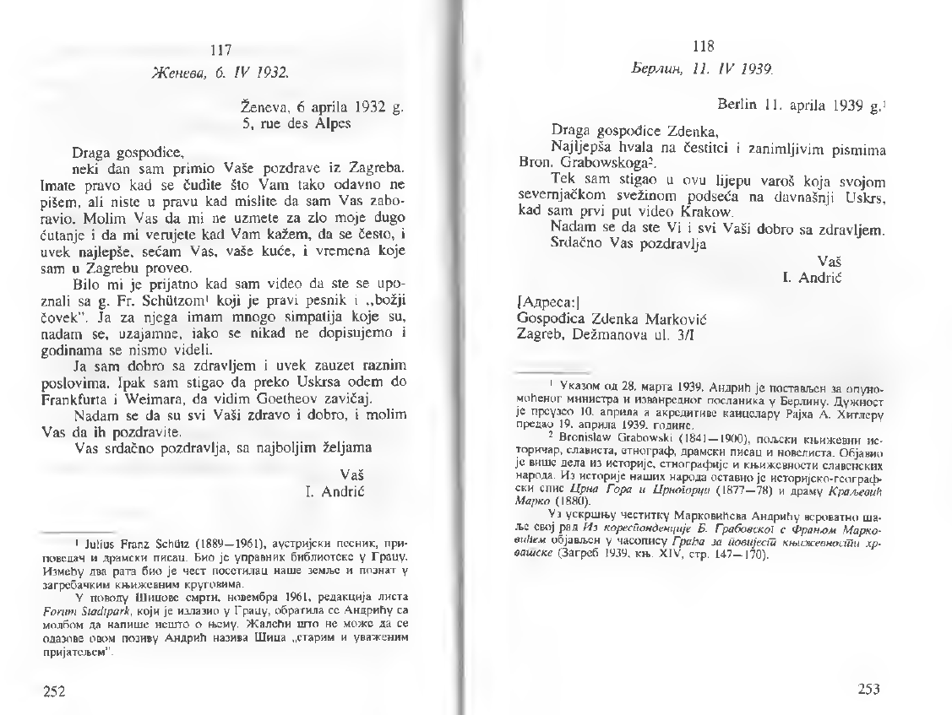
Corpus
15
1925–1939
letters
time span
1
Zdenka Marković
correspondent
recipient

Slide 8
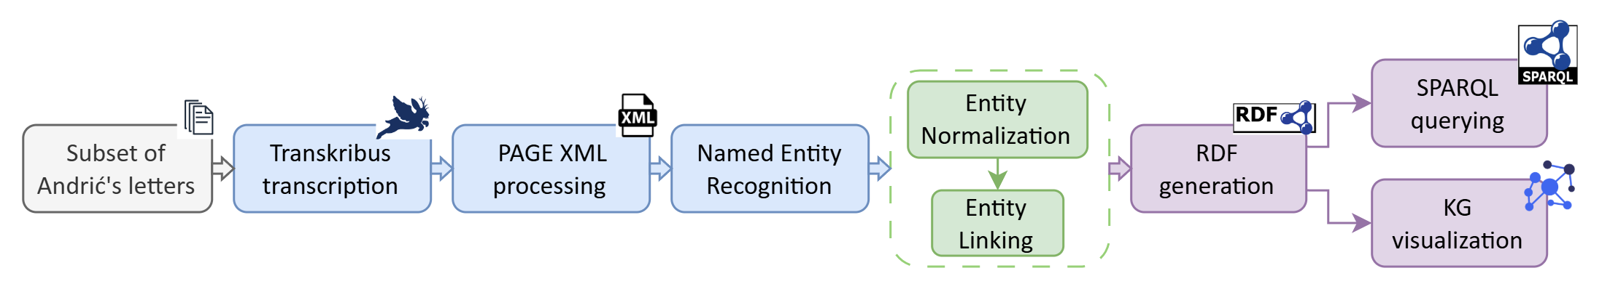
Workflow: Semi-automatic pipeline
1
Transcription
2
Information extraction
3
Normalization & NEL
4
Semantic modeling
5
Exploration
Transkribus + PAGE XML
BERTić NER + regex dates
Rules + Wikidata linking
RDFLib + RDF vocabularies
SPARQL + graph visualization

Slide 9
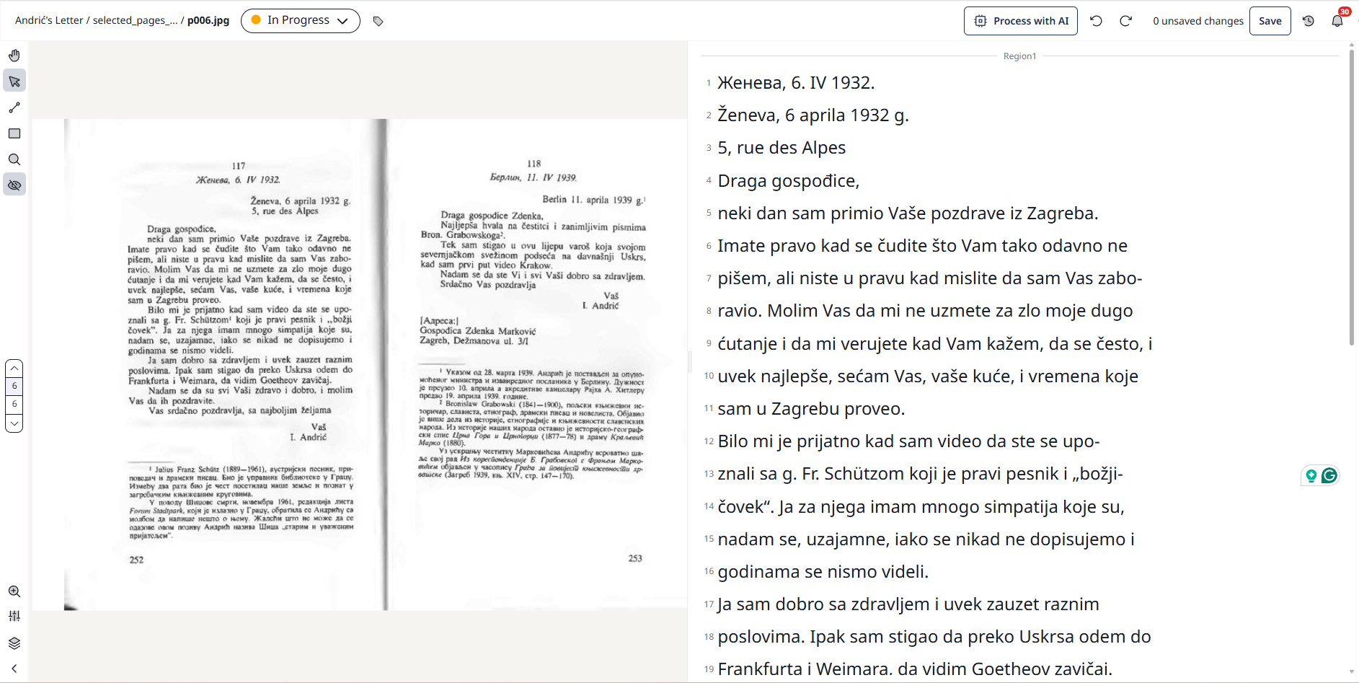
Workflow: Transcription
Transkribus [5] platform:
Burgenland Croatian Typewritten (2010–2019) model produced the best results for mixed Serbian–Croatian Latin-script text, with occasional German and Hungraian words/letters.
[6] Đokić Petrović, M., & Simonović, M. (2025). Burgenland Croatian Typewritten 2010–2019 [Text Recognition Model]. Transkribus. Model ID 442685.

Slide 10
Workflow: PAGE XML processing
The corrected transcription was exported from Transkribus as PAGE XML.
The pipeline converted PAGE XML lines into structured letter records and segmented the letters mainly by place-and-date headers.
letter_id,source_page_files,source_pages,raw_header,text,sender,recipient,date_iso,place_written,date_header_match
letter_0001,0001_p001.xml,1,"Сарајево, 11. II 1925. | Draga gospođice, | vraćajući se sa izbora sjećam Vas se i pozdravljam | Vaš | Ivo Andrić | 11. II. 25 | Mama Vam zahvaljuje na brizi i pozdravlja Vas.",
"Сарајево, 11. II 1925.
Draga gospođice,
vraćajući se sa izbora sjećam Vas se i pozdravljam
Vaš
Ivo Andrić
11. II. 25
Mama Vam zahvaljuje na brizi i pozdravlja Vas.",Ivo Andrić,Ivo Andrić,1925-02-11,,11. II 1925

Slide 11
Workflow: Named Entity Recognition (NER)
NER was applied to the letter texts using the BERTić (classla/bcms-bertic-ner) model [7].
The model was used to identify person (PER), location (LOC), organization (ORG), and miscellaneous entities (MISC) – including publications and literary works.
Dates (DATE) were extracted separately using regular expressions.
letter_id,text,label,start,end,score,model
letter_0001,Сарајево,LOC,0,8,0.9802049398422241,classla/bcms-bertic-ner
letter_0001,Ivo Andrić,PER,95,105,0.9960199594497681,classla/bcms-bertic-ner
letter_0001,11. II 1925,DATE,10,21,1.0,rule-based-date-v1
letter_0001,11. II. 25,DATE,106,116,1.0,rule-based-date-v1
letter_0002,Београд,LOC,0,7,0.9392011761665344,classla/bcms-bertic-ner
letter_0002,Beogradu,LOC,134,142,0.9983125925064087,classla/bcms-bertic-ner
letter_0002,Dobronića,PER,477,486,0.9352021217346191,classla/bcms-bertic-ner
letter_0002,Sczepanska,PER,568,578,0.9743217825889587,classla/bcms-bertic-ner
letter_0002,Poljsku,LOC,642,649,0.978314995765686,classla/bcms-bertic-ner
letter_0002,Pripovetke,MISC,749,759,0.9835421442985535,classla/bcms-bertic-ner
letter_0002,Srp. Knjiž. Zadruzi,ORG,773,792,0.9961962699890137,classla/bcms-bertic-ner
letter_0002,Akademije,ORG,834,843,0.9922829270362854,classla/bcms-bertic-ner
letter_0002,Ivo Andrić,PER,923,933,0.9980722069740295,classla/bcms-bertic-ner
letter_0002,1. IV 1925,DATE,9,19,1.0,rule-based-date-v1
letter_0002,2. IV. 25,DATE,29,38,1.0,rule-based-date-v1

Slide 12
Workflow: NER processing
The NER output was processed using predefined rules:
            Avi, ##gno, and ##na were reconstructed as a single entity mention, Avignona.
            Removed false-positive and out-of-scope candidates, such as Bog (God), Uskrs (Easter).
            Removed the spurious fragment Ma.
            Removed candidates assigned an incorrect entity type, such as Francusku (France) classified as a person.
            Predefined alias mappings normalized abbreviated, inflected, and script variants to canonical forms: I. Andrić was normalized to Ivo Andrić; Beogradu and the Cyrillic variant Београд were normalized to Beograd.
The NER model output contains 99 entities: 32 PER, 59 LOC, 5 ORG, and 3 MISC; 28 DATE entities were extracted separately. Among the most frequent entities are Ivo Andrić, Beograd, Zagreb, Ženeva, Zdenka Marković, and Marselj.

Slide 13
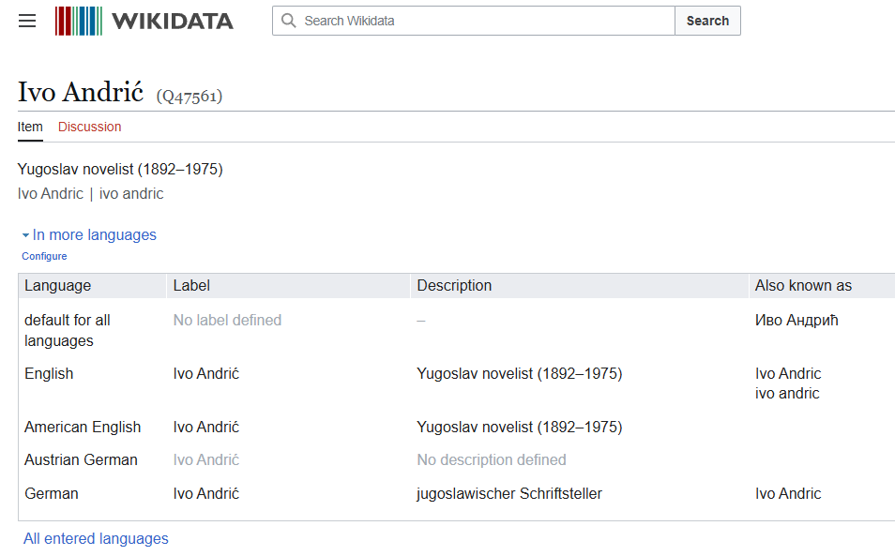
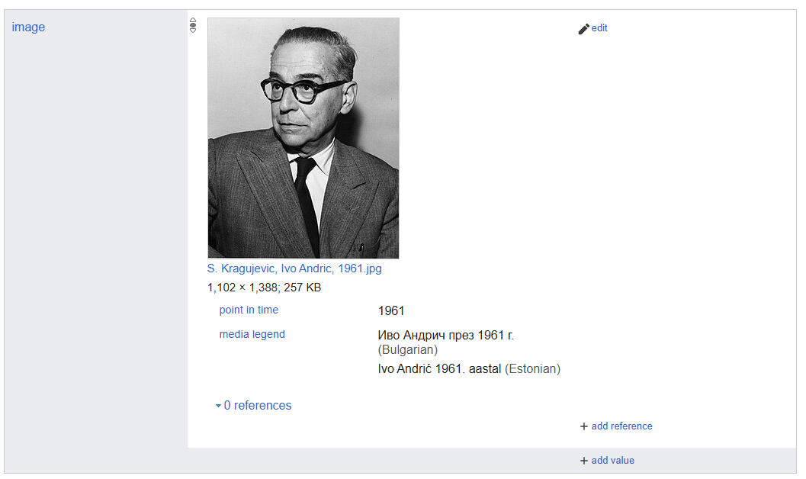
Workflow: Named Entity Linking (NEL)
Entities were linked to Wikidata [8] using the Wikidata API and manually controlled linking rules.
Ivo Andrić,PER,http://www.wikidata.org/entity/Q47561
Ivo Vojnović,PER,http://www.wikidata.org/entity/Q553440
Miroslav Krleža,PER,http://www.wikidata.org/entity/Q325428
Nevistić,PER,http://www.wikidata.org/entity/Q131353567

Slide 14
Workflow: RDF modeling
@prefix andric: <https://example.org/andric-letters/> .
@prefix dcterms: <http://purl.org/dc/terms/> .
@prefix schema: <https://schema.org/> .
@prefix prov: <http://www.w3.org/ns/prov#> .
andric:letter_0001 a andric:Letter;
schema:Message ;
dcterms:identifier "letter_0001" ;
dcterms:isPartOf andric:andric-private-letters-1925-1941 ;
prov:hadPrimarySource "0001_p001.xml" ;
schema:pagination "1" ;
schema:dateSent "1925-02-11"^^xsd:date ;
schema:locationCreated andric:loc_sarajevo ;
schema:sender andric:per_ivo_andric ;
schema:recipient andric:per_zdenka_markovic ;
schema:mentions andric:date_11_ii_25, andric:date_1925,
andric:loc_sarajevo, andric:per_ivo_andric ;
schema:text """Сараjево, 11. II 1925.
Draga gospođice,
vraćajući se sa izbora sjećam Vas se i pozdravljam
Vaš Ivo Andrić
11. II. 25
Mama Vam zahvaljuje na brizi i pozdravlja Vas.""" .
The extracted and normalized data were transformed into an RDF [9] graph using the RDFLib library.
The KG uses a lightweight, project-specific vocabulary with the prefix andric:, alongside established vocabularies such as Schema.org, Dublin Core Terms, PROV-O, RDFS, SKOS, and XSD.
In the current proof-of-concept version, the project namespace is temporary and will be replaced by a stable registered URI in future work.

Slide 15
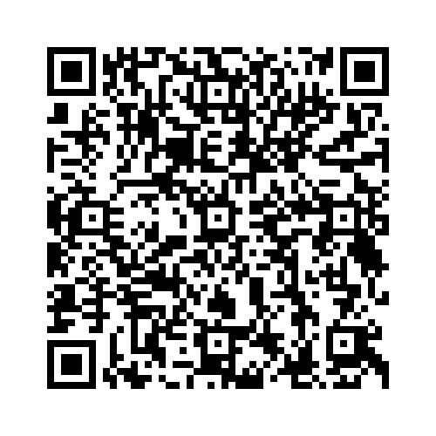
Knowledge graph: Andrić’s Letters
https://github.com/marijadjokic/andrics_correspondence_as_kg/blob/master/data/output/andric_letters_kg.ttl

Slide 16
What can we ask once the letters become a KG?
Social network
Who is mentioned most often? Which persons co-occur across letters?
1
Geography
Where were letters written — and which places were mentioned in the text?
2
Temporal patterns
How do people, places, and institutions change across periods?
3
Contextualization
Which entities can be connected to Wikidata and other external resources?
4

Slide 17
SPARQL
PREFIX ex: <https://example.org/andric-letters/>
PREFIX schema: <https://schema.org/>
PREFIX rdfs: <http://www.w3.org/2000/01/rdf-schema#>
SELECT ?person ?label (COUNT(?letter) AS ?mentions)
WHERE {
?letter a ex:Letter ;
schema:mentions ?person .
?person a schema:Person ;
rdfs:label ?label .
}
GROUP BY ?person ?label
ORDER BY DESC(?mentions)
https://example.org/andric-letters/entity/per_ivo_andric Ivo Andrić 15
https://example.org/andric-letters/entity/per_zdenka_markovic Zdenka Marković 3
https://example.org/andric-letters/entity/per_bronisław_grabowski Bronisław Grabowski 1
https://example.org/andric-letters/entity/per_dobronic Dobronić 1
https://example.org/andric-letters/entity/per_endre_ady Endre Ady 1
https://example.org/andric-letters/entity/per_franz_schutz Franz Schütz 1
https://example.org/andric-letters/entity/per_ivo_vojnovic Ivo Vojnović 1
https://example.org/andric-letters/entity/per_miroslav_krleza Miroslav Krleža 1
https://example.org/andric-letters/entity/per_nevistic Nevistić 1
https://example.org/andric-letters/entity/per_sczepanska Sczepanska 1
https://example.org/andric-letters/entity/per_tadeusz_boy-zelenski Tadeusz Boy-Żeleński 1
https://example.org/andric-letters/entity/per_tugomir_alaupovic Tugomir Alaupović 1
12 result rows
SPARQL [10] is the analytical layer — the planned application will make these questions accessible without requiring users to write SPARQL.

Slide 18
Corpus expansion & Web application
1
2
3
SEMANTiCS 2026
Corpus expansion
Interactive web application
Knowledge graph proof of concept
Beyond the initial 15-letter subset
From RDF data to researcher-facing exploration
New letters: Vojmir Durbešić (2) & Svetislav Stojanović (1)
Search · filtering · entities · timelines · network views
15 letters

Slide 19
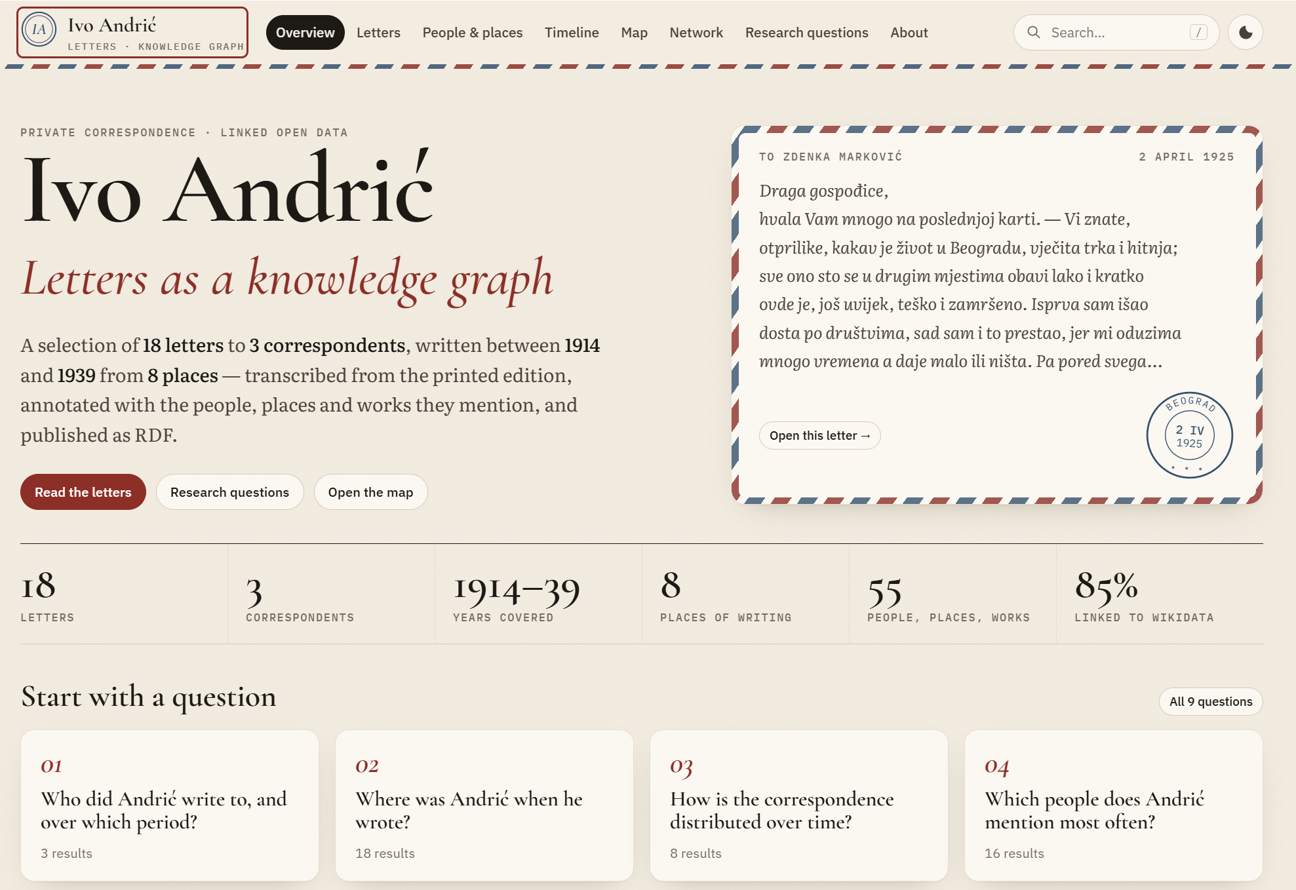
Web application

Slide 20
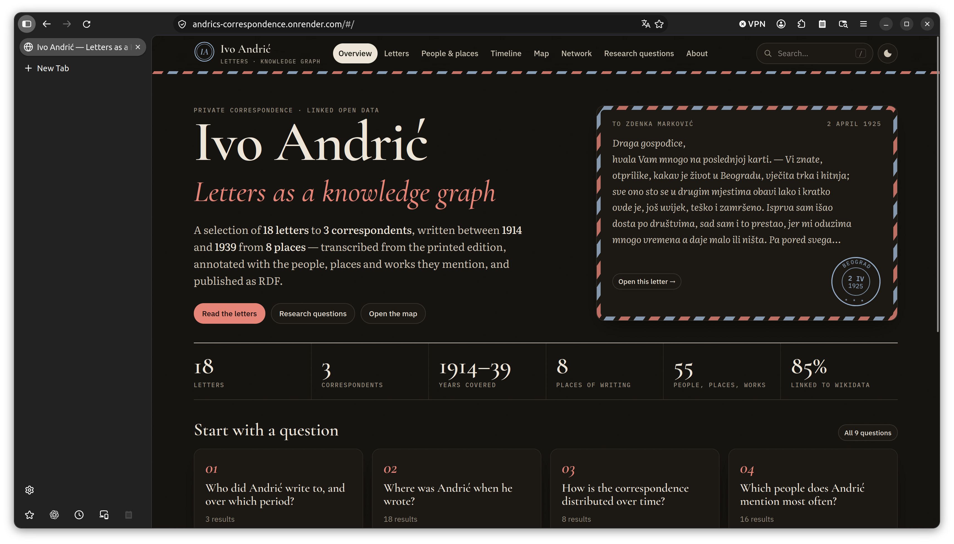
Početna strana

Slide 21
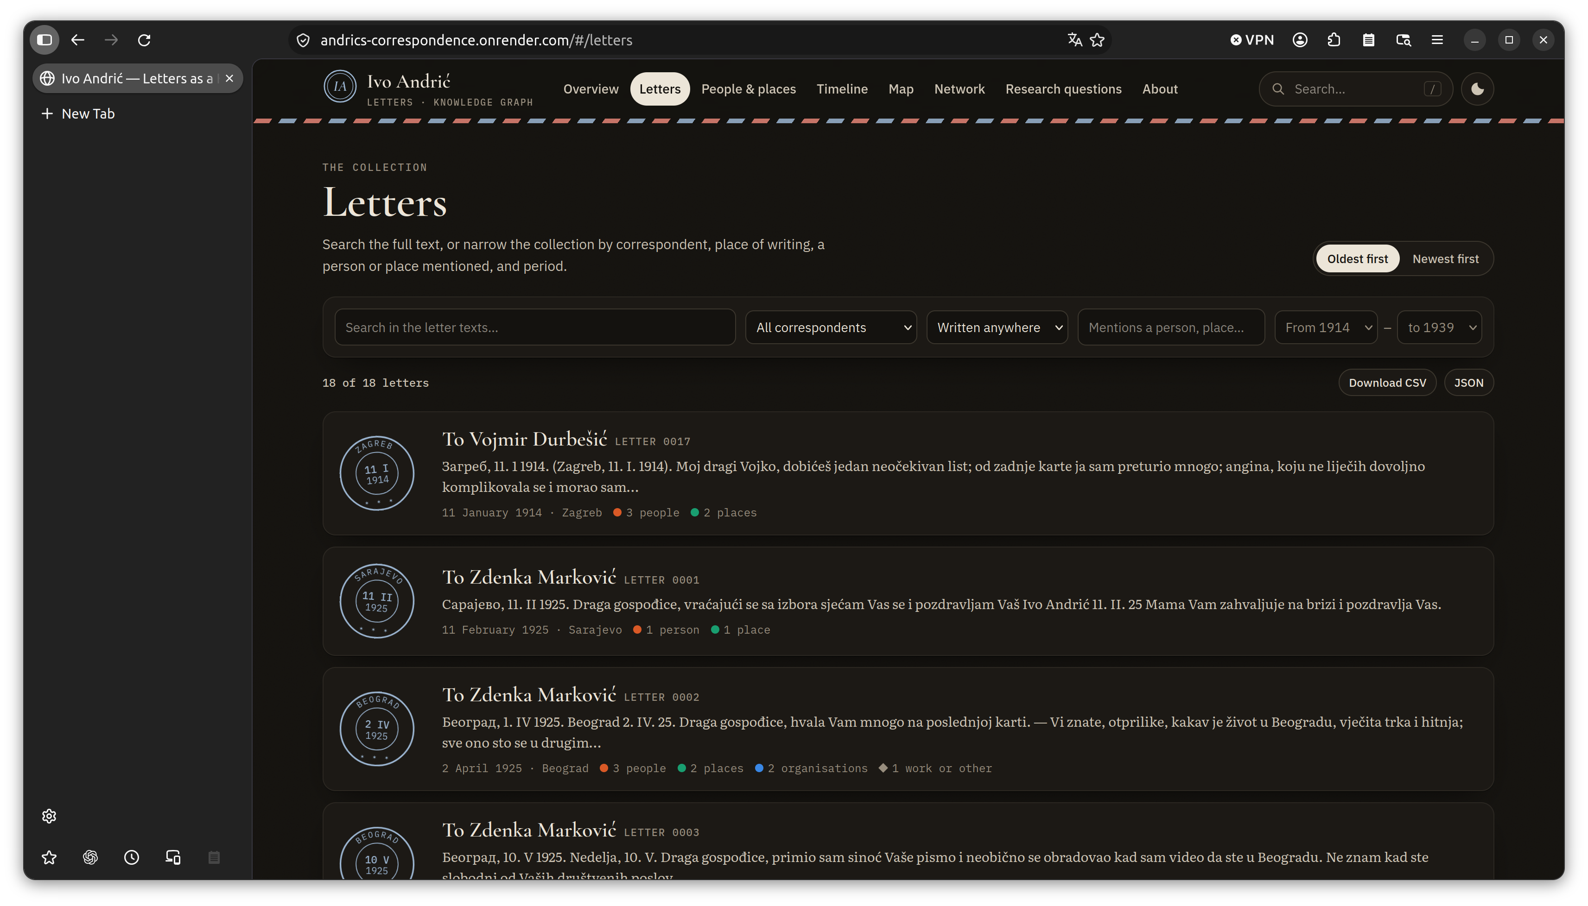
Pregled pisama

Slide 22
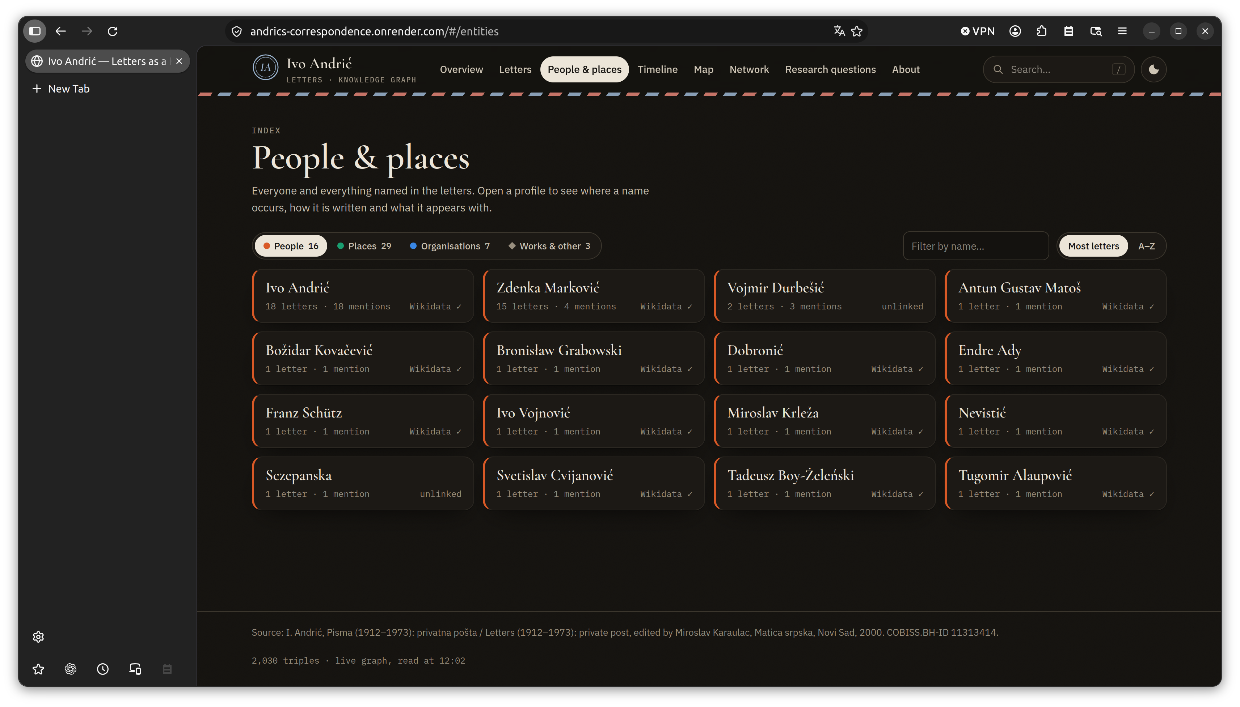
Pregled pojmova

Slide 23
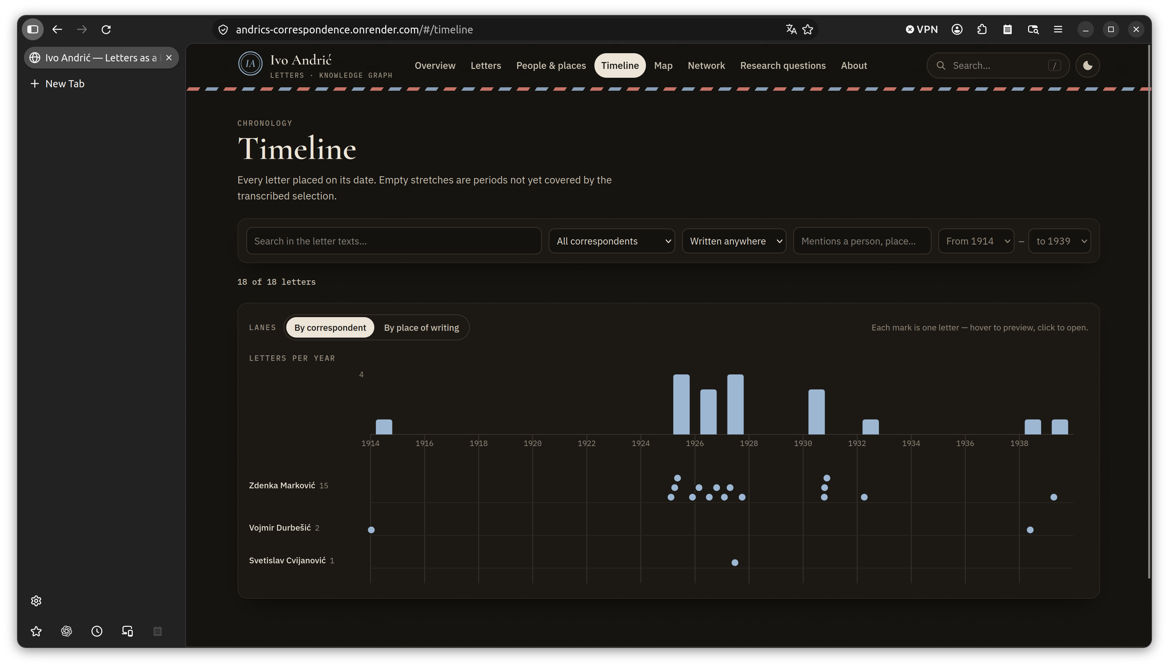
Pregled pisanja i pisama kroz vreme

Slide 24
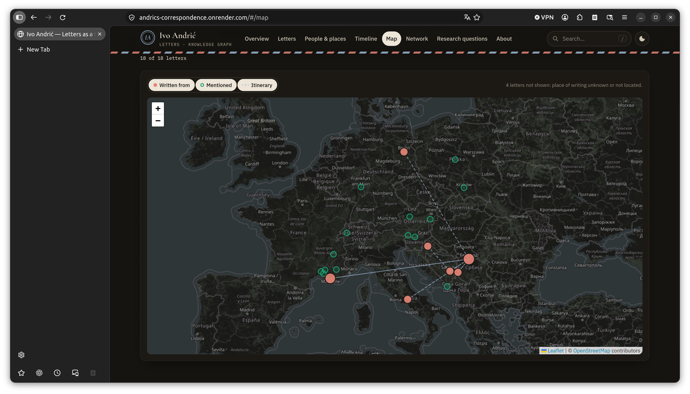
Pregled geografskih pojmova u pismima na mapi

Slide 25
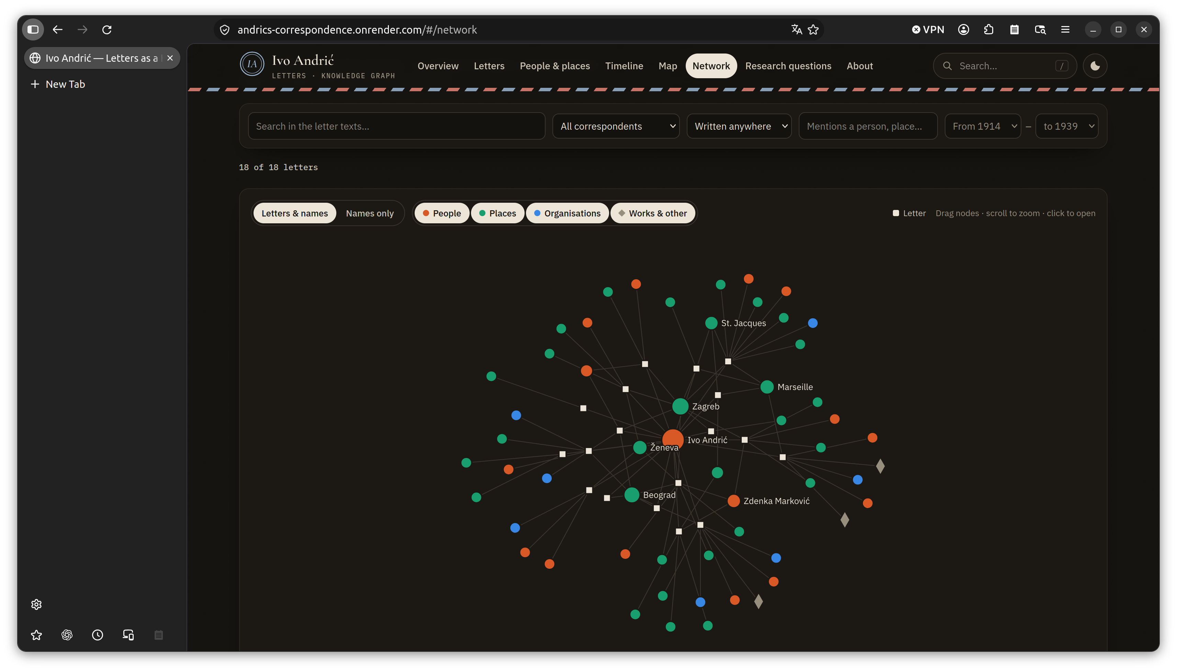
Pregled grafa znanja

Slide 26
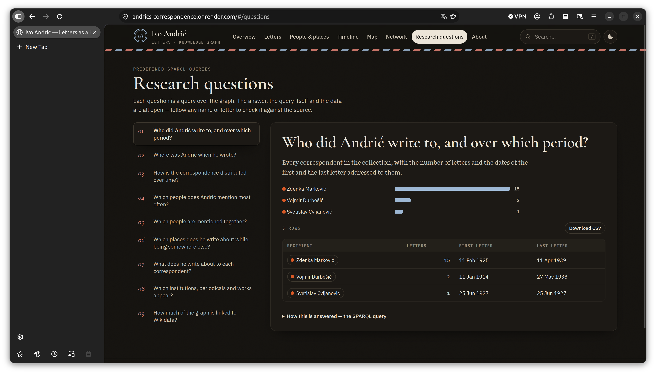
Istraživačka pitanja sa odgovorima prema grafu znanja

Slide 27
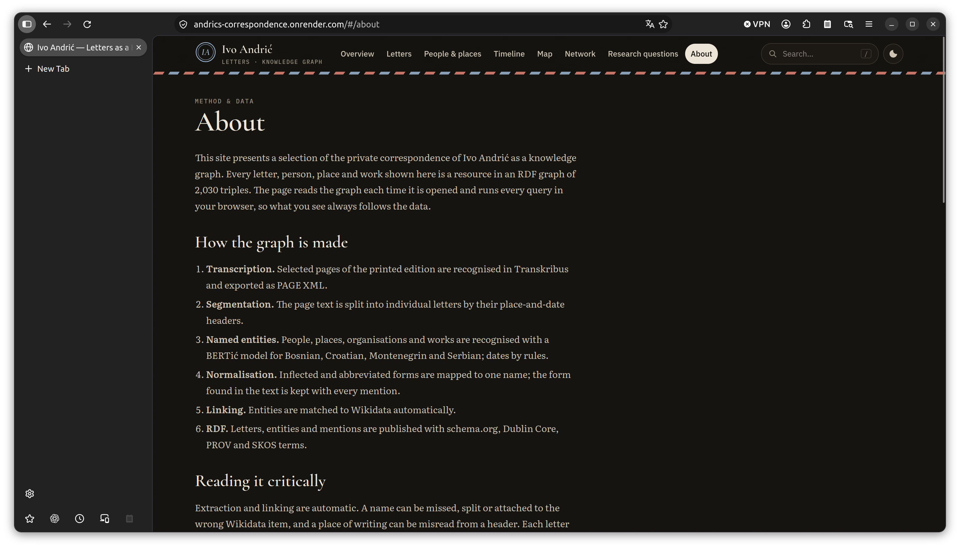
O veb strani

Slide 28
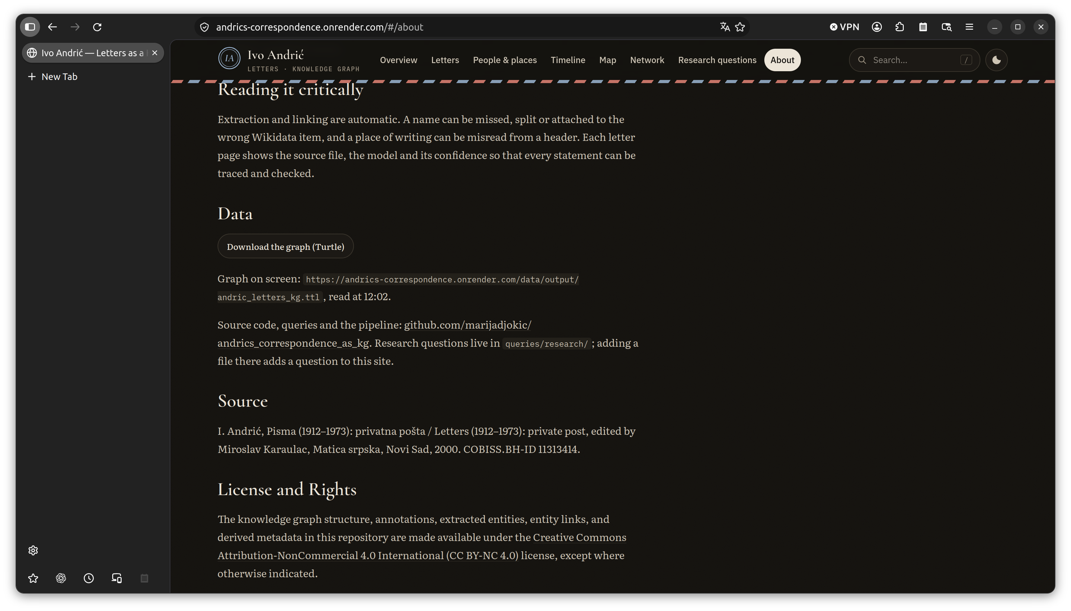
Podaci na veb strani

Slide 29
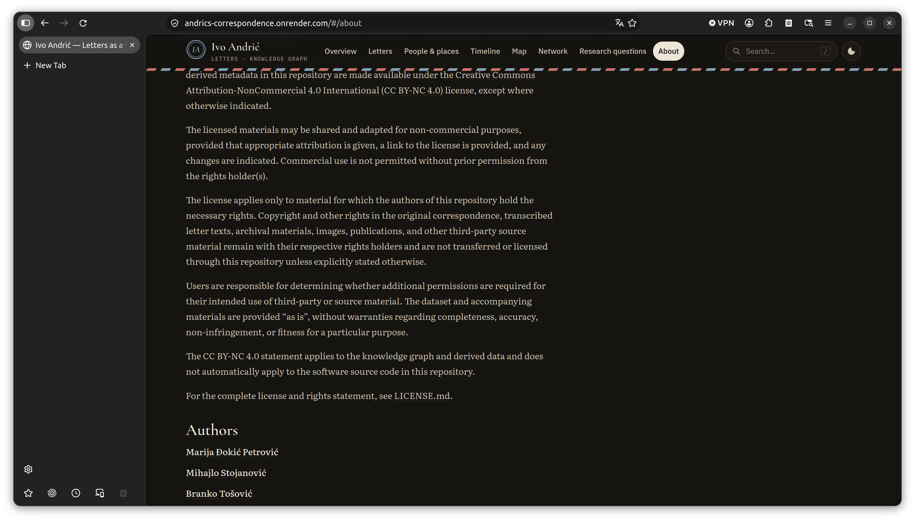
Licenca i autori

Slide 30
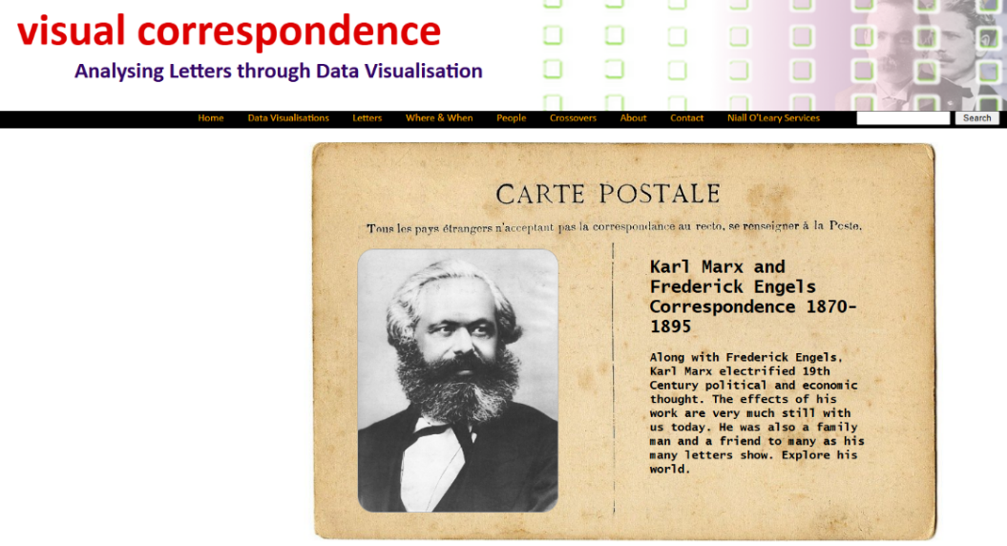
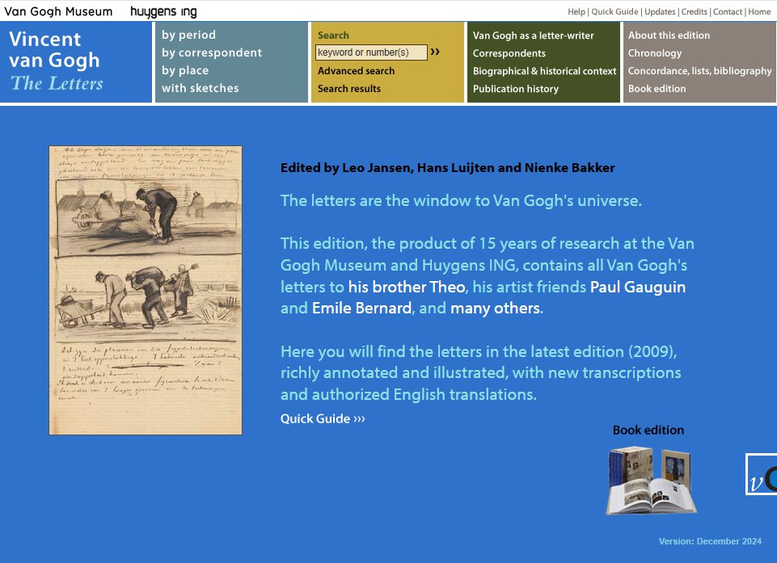
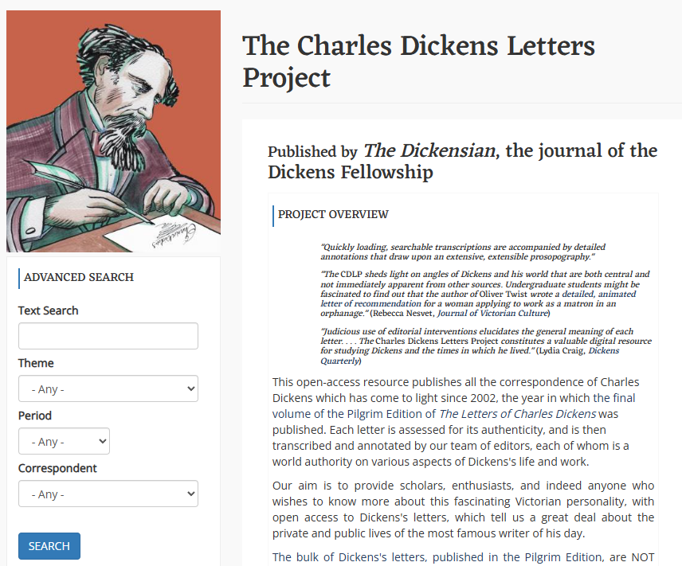
Inspiration

Slide 31
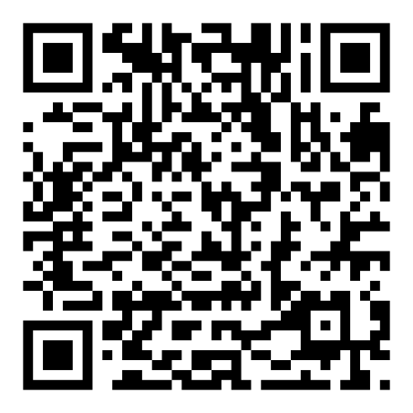
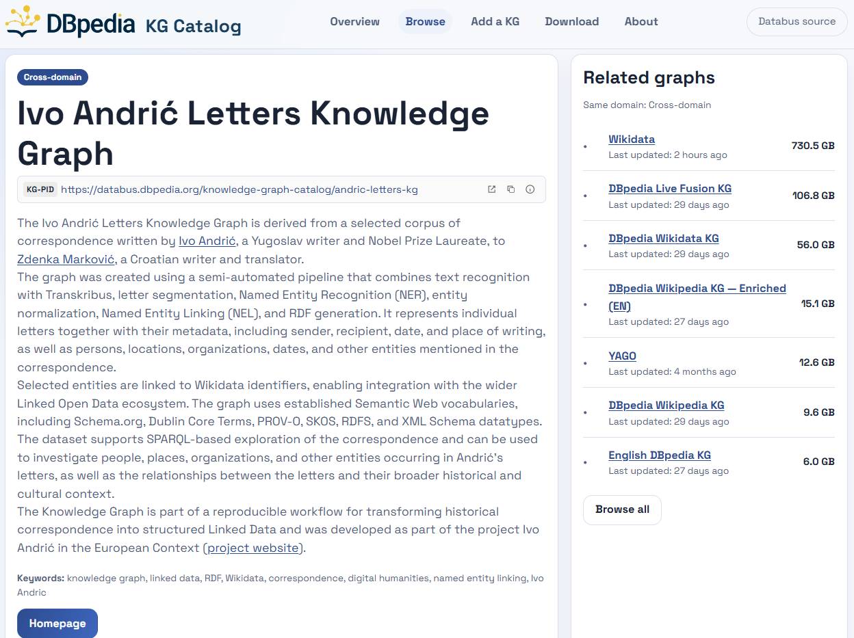
Previous & Future work
Our attendance at SEMANTiCS 2026 was funded by GOBLIN COST Action (CA23147) “Global Network on Large-Scale, Cross-domain and Multilingual Open Knowledge Graphs” (www.cost.eu) → DBpedia KG Catalog
https://kg-catalog.dbpedia.org/kg.html?id=andric-letters-kg
Expand KG to cover all letters and normalize rules for NER and NEL
M. Đokić Petrović. Connecting Ivo Andrić’s Correspondence Knowledge Graph with the Austrian Biographical Dictionary (ÖBL): Exploring Semantic Interoperability, Research Day 10, Austrian Center for Digital Humanities and Cultural Heritage (ACDH), Austrian Academy of Sciences, November 2026, Vienna, Austria [accepted for presentation]

Slide 32
References
[1] Correspondence. “Letter Writing” Correspondence: A Digital Humanities Project. Accessed October 2, 2026. correspondence.ie
[2] I. Andrić, Pisma (1912–1973): privatna pošta, edited by Miroslav Karaulac, Matica srpska, Novi Sad, 2000. COBISS.BH-ID 11313414.
[3] M. Đokić Petrović, D. Bečejski-Vujaklija, J. Đorđević, J. Mitrović, Unveiling Literary Legacies: Integrating Named Entity Recognition and SPARQL to Analyse Andrić’s Letters, in: B. Tošović (Ed.), Andrićs Brief, Institute of Slavic Studies at the Karl-Franzens University of Graz, National and University Library of the Republic of Srpska in Banjaluka, Commission for Stylistics of the International Slavic Committee, World of Book Belgrade, Aletea Belgrade, Graz – Belgrade – Banjaluka, 2025, pp. 231–247.
[4] Đokić Petrović, M., Stojanović, M., & Tošović, B. (2026). Modeling the Letters of Nobel Laureate Ivo Andrić as a Knowledge Graph. SEMANTiCS 2026 – 22nd International Conference on Semantic Systems. Posters, Demos, Blue Sky, and Tutorials, September 2026, Ghent, Belgium.
[5] READ-COOP SCE, Transkribus, Innsbruck: READ-COOP SCE. https://transkribus.eu/, 2026. Accessed: 10 June 2026.
[6] Đokić Petrović, M., & Simonović, M. (2025). Burgenland Croatian Typewritten 2010–2019 [Text Recognition Model]. Transkribus. Model ID 442685.
[7] N. Ljubešić, D. Lauc, BERTić - The Transformer Language Model for Bosnian, Croatian, Montenegrin and Serbian, in: B. Babych, O. Kanishcheva, P. Nakov, J. Piskorski, L. Pivovarova, V. Starko, J. Steinberger, R. Yangarber, M. Marcińczuk, S. Pollak, P. Přibáň, M. Robnik-Šikonja (Eds.), Proceedings of the 8th Workshop on Balto-Slavic Natural Language Processing, Association for Computational Linguistics, Kyiv, Ukraine, 2021, pp. 37–42. URL: https://aclanthology.org/2021.bsnlp-1.5/.
[8] Wikimedia Foundation, Wikidata, 2026. URL: https://www.wikidata.org/, accessed: 10 June 2026.
[9] World Wide Web Consortium (W3C), RDF 1.1 Concepts and Abstract Syntax, W3C Recommendation, 25 February 2014. URL: https://www.w3.org/TR/rdf11-concepts/.
[10] World Wide Web Consortium (W3C), SPARQL 1.1 Query Language, W3C Recommendation, 21 March 2013. URL: https://www.w3.org/TR/sparql11-query/.

Slide 33

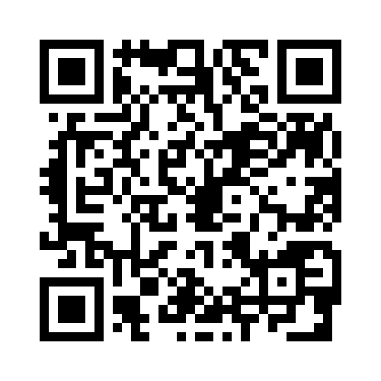
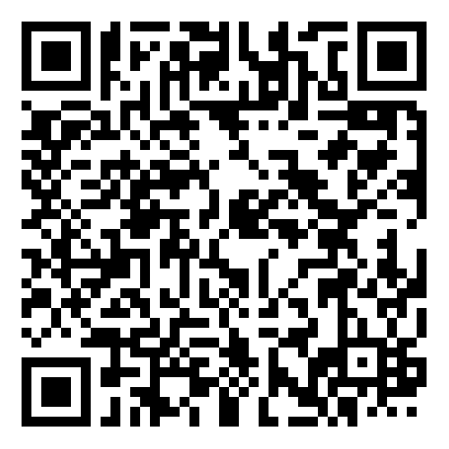
Thank you
GitHub project
Ivo Andrić Letters – Web application
Marija Đokić Petrović – LinkedIn

