Slide 1
Hedgehog’s Home by Branko Ćopić in English Translation
Marija Todorova
Hong Kong Baptist University
September 2013

Slide 2
Ježeva kućica, Branko Ćopić, illustrated by Vilko Selan Gliha, Zagreb: Naša Djeca Zagreb 1949
Hedgehog’s Home, Branko Ćopić, translated by Susan D. Curtis, illustrated by Sanja Ražćek, London: Istros Books 2011

Slide 5
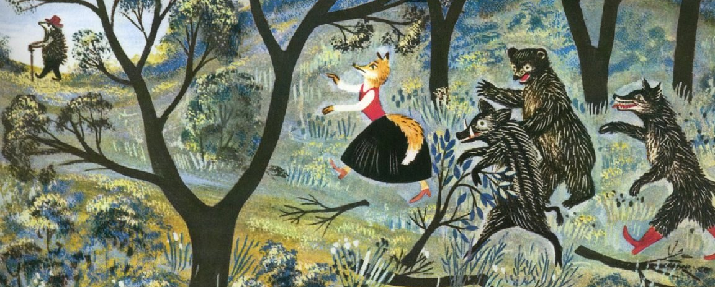

Slide 6
Krvnika vuka, jadna mu majka umlati brzo seljačka hajka. Trapavog medu, oh, kuku, lele, do same smrti izbole pčele I divlja svinja pade k'o kruška, smače je zimus lovačka puška
The butcher wolf, poor his mother,
was quickly beaten to death by peasant chase.
The slothful/sluggish bear, oh, poor him
bees stung to death.
And the boar fell down like a pear,
Killed by a hunters gun in winter.
(my translation, my emphases)
The greedy old wolf, just up to no good
Was chased by farmers, right out of the wood
And slovenly bear with great honeyed paw
Was beaten by bees till he was no more
And even the boar, that horrid grunter
Fel into the trap set by the hunter
Ježurka često zdravicu diže: u zdravlje lije i njene kuće, za pogibiju lovčeva Žuće.
Ježurka frequently raises his glass:
For the health of the fox, and his home,
and for the death of hunter’s dog Žućo.
(my translation, my empharses)
To swift demise of hunter’s fierce hound!’

Slide 7
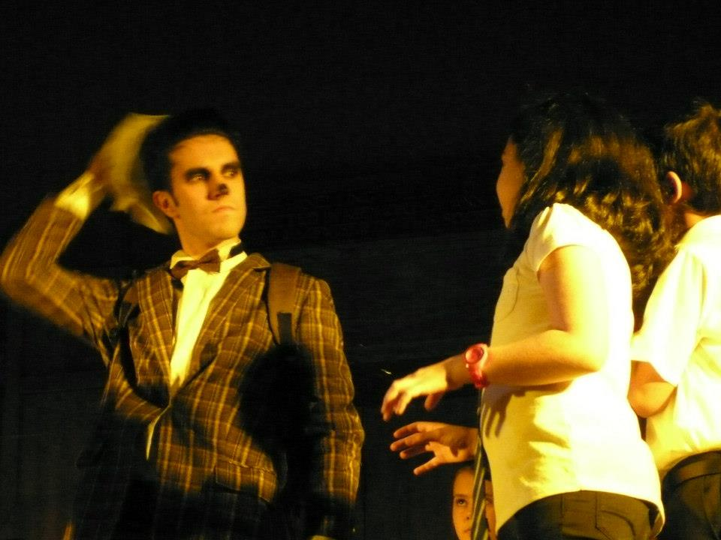

Slide 8
Thank you !
marija.todorova@gmail.com
Klopche.blogspot.com
@MarijaTodorova

